Slide 1

INSTITUTE UIE
DEPARTMENT ACADEMIC UNIT-1
Bachelor of Engineering (Computer Science & Engineering)
Subject Name: Introduction to Electrical & Electronics Engineering
Subject Code: 23ECH_101
Prepared By
Dr. Shikha
Unit-1 Chapter-1
Series & Parallel Combination of resistance
Voltage Division & Current Division Rule
Lecture No. 1.1.3
DISCOVER . LEARN . EMPOWER

Slide 2
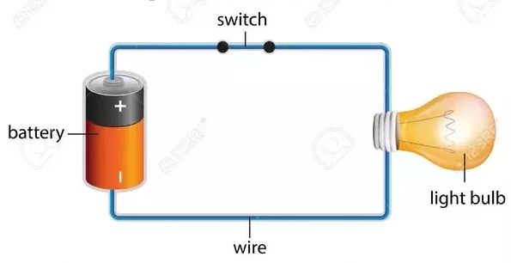
Lecture Objectives
S. No. | Objectives
1 | Understand Electrical & Electronics Engineering Fundamentals
2 | To prepare students to perform the analysis and design of various Electrical & digital electronic circuits.
https://www.quora.com/What-are-the-differences-between-a-circuit-and-an-electric-circuit

Slide 3
Course Objectives
S. No. | Objectives
1 | Understand Electrical & Electronics Engineering Fundamentals
2 | To prepare students to perform the analysis and design of various Electrical & digital electronic circuits.
https://www.quora.com/What-are-the-differences-between-a-circuit-and-an-electric-circuit

Slide 4
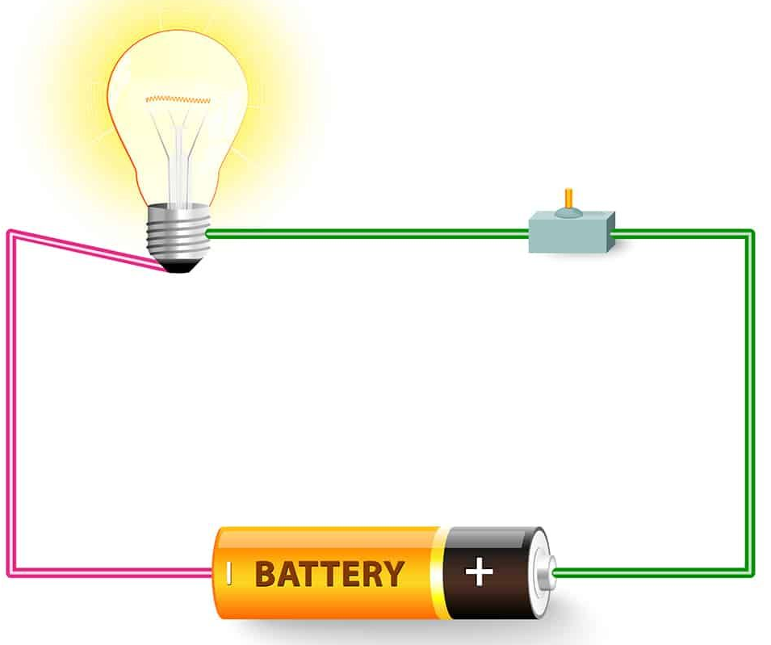
Course Outcomes
CO Number | Title | Level
CO1 | To identify the different types of electrical elements and the basic op-amp circuit elements and to illustrate the various types of motors, transducers. | Remember
CO2 | To understand basic principles of transformers, transducers, op-amps, DC and AC motors and to compare the different methods for analysing electrical and magnetic circuits. | Understand
CO3 | To derive the relationships between parameters in electric and magnetic circuits and motors and to determine specifications of op-amps. | Analyze
CO4 | To solve the basic problems related to electric circuits, magnetic circuits and motors and to assess the characteristics of different configurations of op-amps. | Evaluate
CO5 | To design the different applications of transducers, motors as well as the op-amps like adders, subtractor and comparators. | Create
https://in.pinterest.com/pin/240661173823316229/

Slide 5
Importance of Introduction to Electrical & Electronics Engineering
Use from home appliances to industrial plants.
Usage in communication and satellite navigation system.
Handles in electronics equipment and computers.
Deals with the problem of power transmission and motor control.
Control and monitor the medical appliances in hospitals.
High voltage applications with heavy current.
Robotics applications.
Product designing and development.

Slide 6
Content
Voltage current relation for resistance.
Voltage current relation for inductance.
Voltage current relation for capacitance.
Series connection of resistance.
Parallel connection of resistance.
Voltage division rule.
Current division rule.

Slide 7
Voltage current relation for resistance
For resistance we know in a circuit when we have voltage source and current flowing in the circuit then
From ohm’s law:
V= IR
Similarly we will get current as:
I = V/R

Slide 8
Voltage current relation for inductance
The inductor is a coil which stores energy in the magnetic field Consider a wire of length l forming a loop of area A as shown on Figure.
A current i(t) is flowing through the wire as indicated. This current generates a magnetic field B which is equal to
B = µ i(t)
Where µ is the magnetic permeability of the material enclosed by the wire

Slide 9
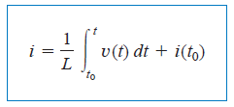
Voltage current relation for inductance
The magnetic flux, Φ, through the loop of area A is
Φ = B.A
Where we have defined L= Aµ/l
By using maxwell equation we will solve it and get
V = Ldi/dt
After doing integration we will get current

Slide 10
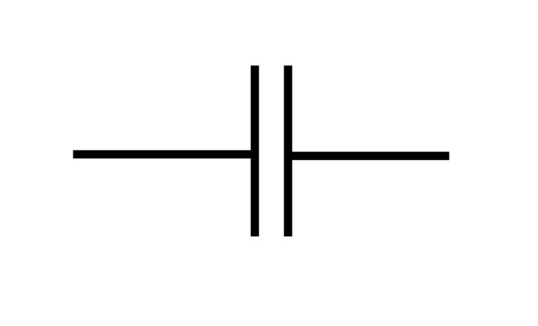
Voltage current relation for capacitance
In both digital and analog electronic circuits a capacitor is a fundamental element.
It enables the filtering of signals and it provides a fundamental memory element.
The capacitor is an element that stores energy in an electric field.
Fig.1 capactiance
https://www.stitchingworlds.net/experimentation/measuring-textile-capacitors/

Slide 11
Voltage current relation for capacitance
When a voltage v is applied across the plates, a charge +q accumulates on one plate and a charge –q on the other.
If the plates have an area A and are separated by a distance d, the electric field generated across the plates is
E =q/ €A
€ is permittivity of material.
and the voltage across the capacitor plates is
V =Ed
V= qd / €A

Slide 12
Voltage current relation for capacitance
So current is in a capacitor will be
I =dq/dt
I =C dv/dt
Hence these are the voltage current relation for resistance, inductance and capacitance.

Slide 13
Series connection of resistance
A series circuit is a circuit in which resistors are arranged in a chain, so the current has only one path to take.
The current is the same through each resistor.
The total resistance of the circuit is found by simply adding up the resistance values of the individual resistors:
So equivalent resistance of resistors in series : R = R₁ + R₂ + R₃ + ...

Slide 14
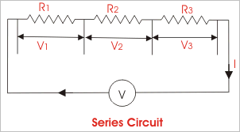
Series connection of resistance
Hence if there are three resistance are connected in series with voltage V then we will get equivalent resistance as shown in figure below:
Fig.2 Series connection of resistance
https://www.electrical4u.com/electrical-dc-series-and-parallel-circuit/

Slide 15
Parallel connection of resistance
A parallel circuit is a circuit in which the resistors are arranged with their heads connected together, and their tails connected together.
The current in a parallel circuit breaks up, with some flowing along each parallel branch and re-combining when the branches meet again.
The voltage across each resistor in parallel is the same.

Slide 16
Parallel connection of resistance
The total resistance of a set of resistors in parallel is found by adding up the reciprocals of the resistance values, and then taking the reciprocal of the total:
So equivalent resistance of resistors in parallel:
1 / R = 1 / R₁ + 1 / R₂ + 1 / R₃
Fig.3 Parallel connection of resistance
electrical4u.com/electrical-dc-series-and-parallel-circuit/

Slide 17
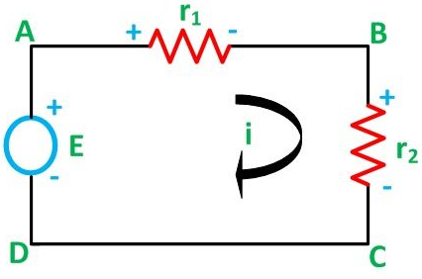
Voltage Division Rule
The voltage division rule can be understood by considering a series circuit shown below.
In a series circuit, voltage is divided, whereas the current remains the same.
There are two resistance such as r1 and r2 connected across dc supply voltage.
Fig.4 Voltage division rule
https://circuitglobe.com/current-division-and-voltage-division-rule.html

Slide 18
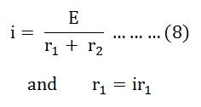
Voltage Division Rule
Let us consider a voltage source E with the resistance r₁ and r₂ connected in series across it.
As we know,
i = V/R or we can say I = E/R
Therefore, the current (i) in the loop ABCD will be:

Slide 19

Voltage Division Rule
By putting the value of I from equation (8) in equation (9) the voltage across the resistance r₁ and r₂ respectively are given by the equation shown below as:

Slide 20
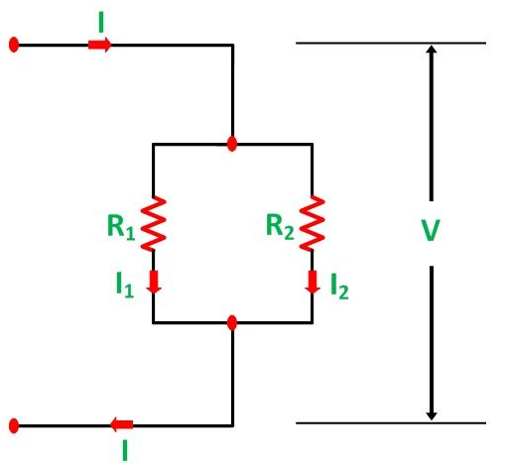
Current Division Rule
A parallel circuit acts as a current divider as the current divides in all the branches in a parallel circuit, and the voltage remains the same across them.
There are two resistance R1 and R2 are connected in parallel.
Fig.5 Current division rule
https://circuitglobe.com/current-division-and-voltage-division-rule.html

Slide 21

Current Division Rule
The current I has been divided into I₁ and I₂ into two parallel branches with the resistance R₁ and R₂ and V is the voltage drop across the resistance R₁ and R₂.
Then the equation of the current is written as:

Slide 22


Current Division Rule
Let the total resistance of the circuit be R and is given by the equation shown below:
Now, putting the value of R from the equation (2) in the equation (3) we will get

Slide 23
Summary
Build up relation of voltage and current for resistance.
Build up relation of voltage and current for inductance.
Build up relation of voltage and current for capacitance.
Series connection of resistance.
Parallel connection of resistance.
Voltage division rule.
Current division rule

Slide 24
Frequently Asked Questions
What is the difference between voltage division and current division rule?
What is meant by series combination of resistance?
What is meant by parallel combination of resistance?
Give the relationship of voltage and current fro resistance.
Build up the relationship of voltage and current for capacitance.

Slide 25
Practice Questions
If we have three resistance of 10ohm, 5 ohm and 20ohm so what will be the equivalent resistance if they are connected in parallel?
In a series circuit if two resistances of 20ohm and 50ohm are connected across 50V dc supply so what will be the voltage across each resistance?
A current source of 10A is applied in a circuit which carries two resistances of 40ohm and 80ohm so how can we measure current in both the resistance?

Slide 26

LEARNING OUTCOMES
To make students understand
Concepts of voltage current relation for resistance, inductance and capacitance.
Fundamentals of series and parallel combination of resistance.
Concepts of voltage division and current division rule.

Slide 27
Assessment Pattern
A Assignment (each assignment) | B Time Bound Surprise Test (each test) | C Quiz (each quiz) | D Mid Semester Test(one per test) | E Homework | F Discussion Forums | G Attendance and engagement Score on BB
10 | 12 | 4 | 20 | NA | NA | 2

Slide 28
References
Textbooks of Basic Electrical & Electronics Engineering:
Fundamentals of Electrical Circuits by Charles k.
Electrical Technology by Surinder Pal Bali, Pearson Publications.
Websites:
https://ocw.mit.edu/courses/electrical-engineering-and-computer-science/6-071j-introduction-to-electronics-signals-and-measurement-spring-2006/lecture-notes/capactr_inductr.pdf
https://www.electronics-tutorials.ws/resistor/res_5.html
http://physics.bu.edu/py106/notes/Circuits.html
https://circuitglobe.com/current-division-and-voltage-division-rule.html

Slide 29
THANK YOU
For queries
Email: neeru.cse@cumail.in

